Slide 1
Unheard Voices
By the College and Career Council at Mikva Challenge
Summer 2016

Slide 2
Recommendations for Chicago Public Schools

Slide 3
Recommendation One
Provide students with an ease of transition to college by equipping them with social support networks beginning in their freshman year of high school

Slide 4
Recommendation Two
Hire teachers of color to represent the diverse student population, so students can better connect with their cultural identity and cultural roots

Slide 5
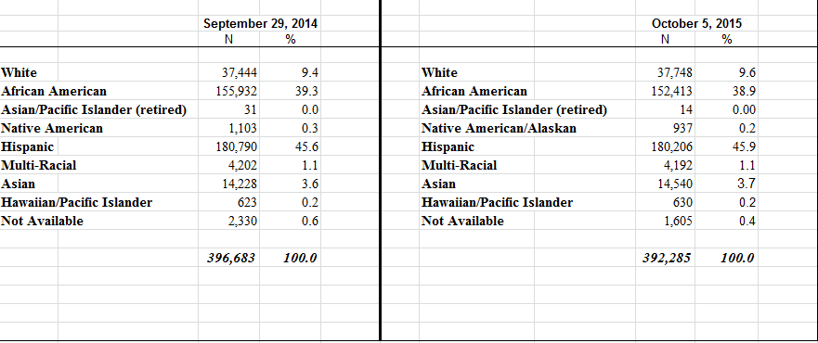
CPS Race Demographics

Slide 6
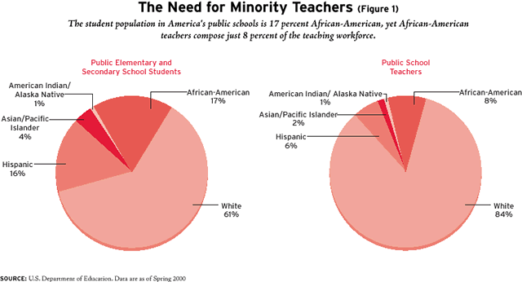
Why Teachers of Color Matter

Slide 7
Recommendation Three
Provide CPS students with the life skills needed to graduate college successfully, in four years, and be job ready

Slide 8
Recommendation Four
Provide a more comprehensive education for high school students on how to understand the financial aid process of college readiness that includes after school programs that are revolved around financial aid

Slide 9
Recommendation Five
Provide students with counselors and teachers that are more effective and supportive in providing mental and emotional support to students’ needs inside and outside the classroom

Slide 10
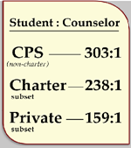
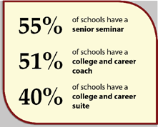
Student to Counselor Ratio in CPS

Slide 11
Thank You
Q & A
For follow up questions or comments contact Josh Prudowsky at Mikva challenge at:
Joshua@mikvachallenge.org

